Slide 1

Loan Lending Club Case Analysis
Presented By:
Vijay Sansuddi
GitHub : - https://github.com/vijbgm
Email:vijbgm@yahoo.com
Satyander kaur
GitHub : https://github.com/Satyander1
Email : Satyander.kaur@gmail.com

Slide 2
Contents
Problem Statement
Business Understanding
Risk
Analysis Approach
Univariate Analysis
Bivariate Analysis
Multivariate Analysis
Factor whether an applicant will be Defaulter
Decisive Factor whether an applicant will be Defaulter

Slide 3
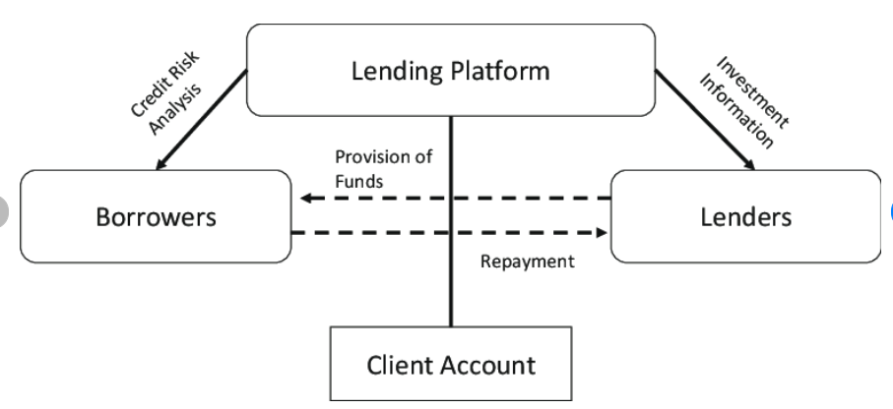
Problem Statement
Lending Club is a marketplace for personal loans that matches borrowers who are seeking a loan with investors looking to lend money and make a return.
The company wants to understand the driving factors (or driver variables) behind loan default, i.e., the variables which are strong indicators of default. The company can utilize this knowledge for its portfolio and risk assessment.

Slide 4
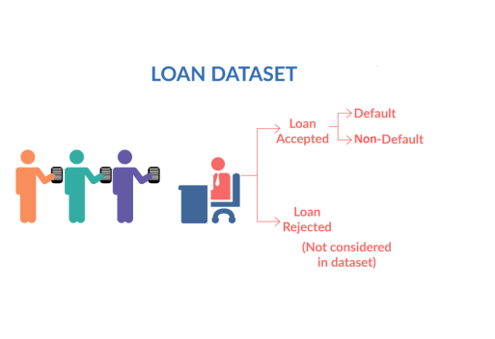
Business Understanding
When a person applies for a loan, there are two types of decisions that could be taken by the company:
Loan accepted: If the company approves the loan, there are
possible scenarios described below:
Fully paid:
Current:
Charged-off:
2. Loan rejected: The company had rejected the loan
(because the candidate does not meet their requirements etc.).

Slide 5
Risk
When the company receives a loan application, the company must decide for loan approval based on the applicant’s profile. Two types of risks are associated with the bank’s decision:
If the applicant is likely to repay the loan, then not approving the loan results in a loss of business to the company
If the applicant is not likely to repay the loan, i.e., he/she is likely to default, then approving the loan may lead to a financial loss for the company

Slide 6
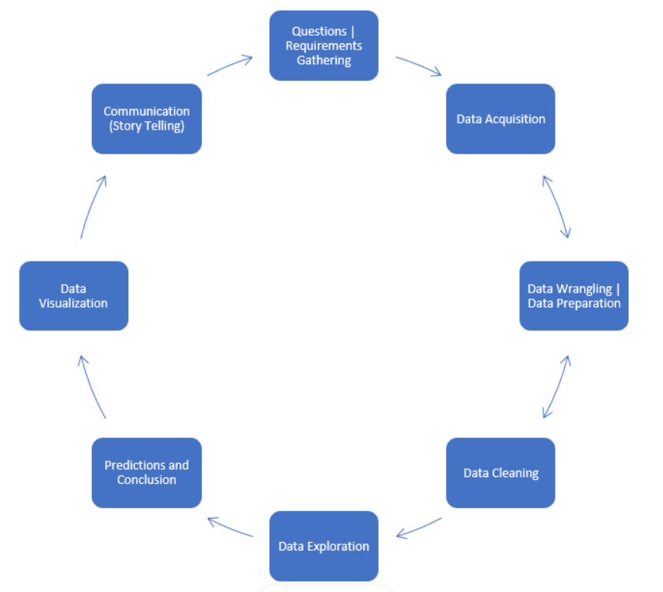
Analysis Approach
Step 1 →Fix Rows and Columns →Fix missing values→
Standardize value Filter Data
Step 2 →Understanding data using only one variable
(univariate Analysis)
Step 3 →Understanding data using two variable
(Bivariate Analysis)
Step 4 →Understanding data using more than two variable
(multivariate Analysis)
Step 5 →Conclusion → Recommendations→ Factors

Slide 7
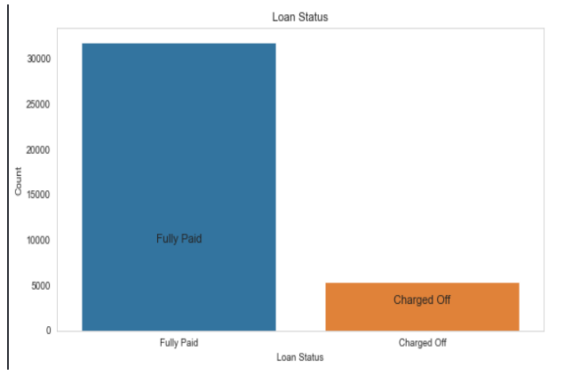
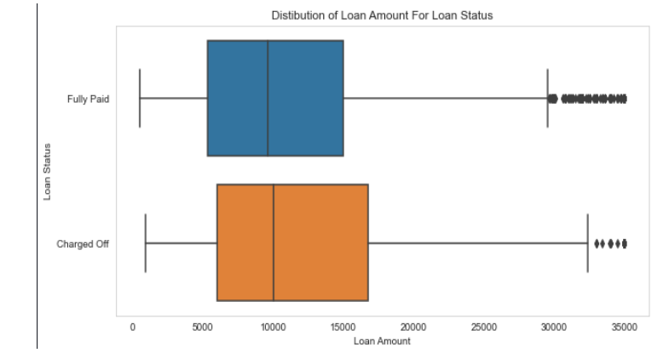
Loan Status and Amount
Loan Amount: It varies from 500 to 35000 with a median of 10000. Loan amount is majorly small and very few clients have taken large loans and larger it goes we have higher chance of defaulting.
Loan Status: The number of charged off loan is much smaller(14.5%) compared to total count.

Slide 8
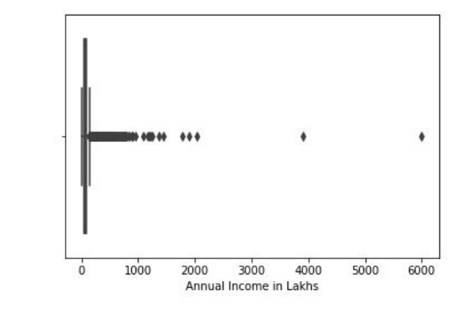
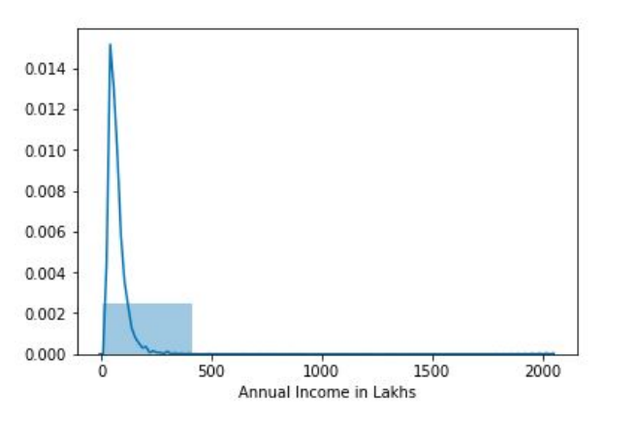
Income Analysis for the loan applicants
Observation:
Most of the applicants have income between 0 to 5 lakhs.
There are two applicants having income above 30 lakhs

Slide 9
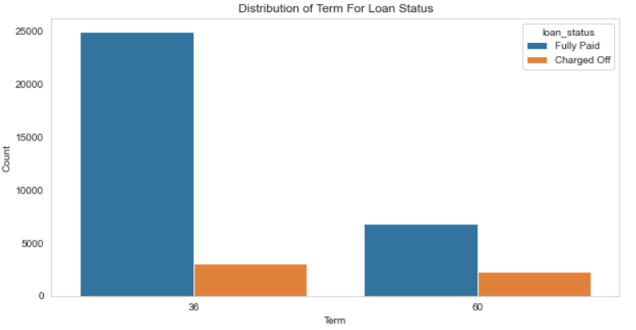
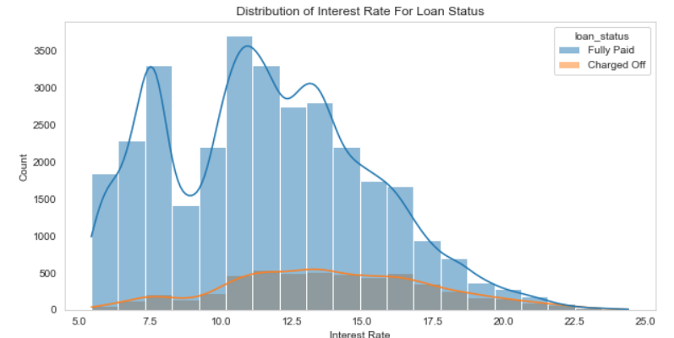
Term and Interest Rate
Interest Rate: The count of loan taken varies with interest rate showing peak around in 5-15 bracket and decreasing slowly whereas the chance of defaulting increases with interest rate
Loan Term: The Loans taken for 36-month term are much more than 60 months and have lower chance of defaulting.

Slide 10
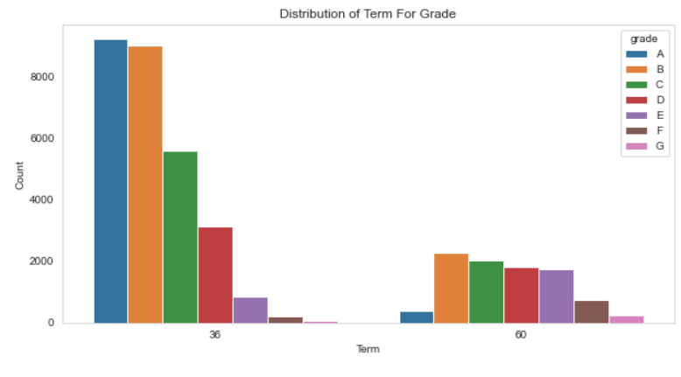
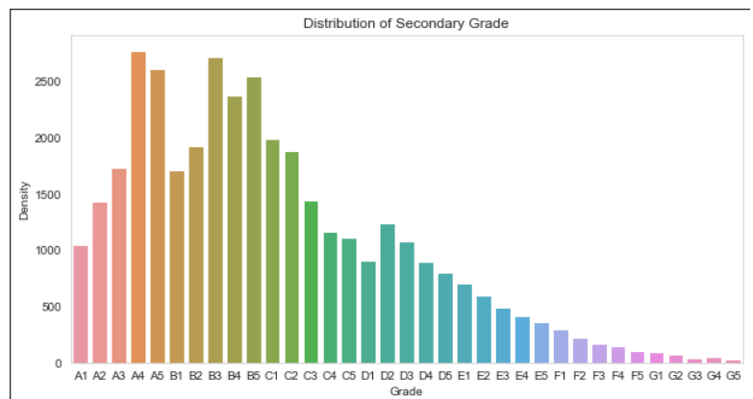
Grade and Sub-Grade
Sub Grade: This provides more insight that the loans within grade are more skewed towards lowered sub grades.
Grade: The loan approved are majorly of higher grade as they are of low risk thus low chance of defaulting. 60-month term loans have larger number of lower grade loans with high risk.

Slide 11
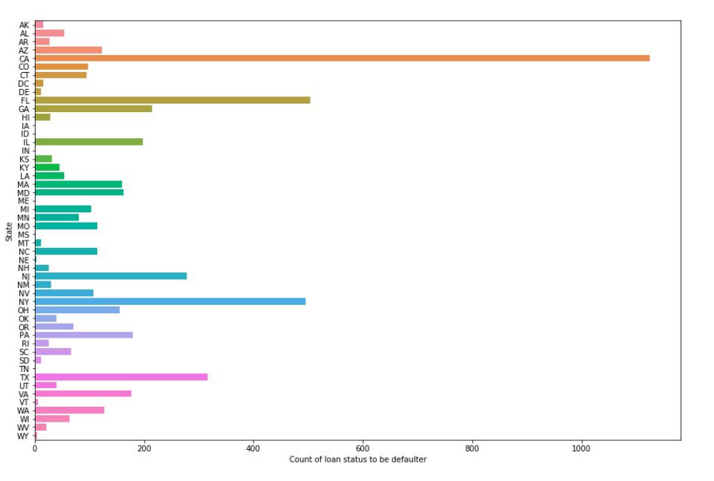
Loan Defaulters by State Analysis
Observation:
Applicants from state CA have high tendency to default the loan

Slide 12
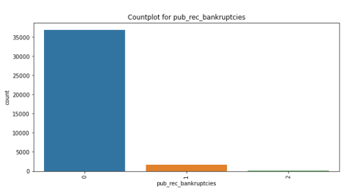
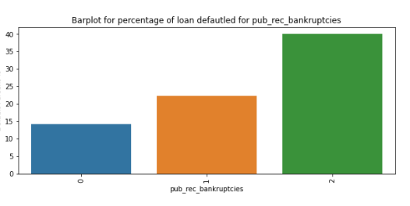
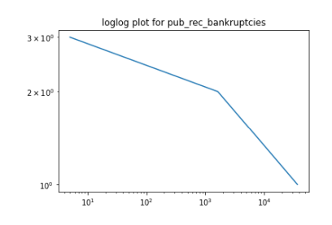
Analysis on Public Bankruptcies
Borrowers zero public bankruptcies have the greatest number of loans
The loan defaulted percent increases for one or more public bankruptcies record
The loan defaulted percent for one or more bankruptcies is higher than overall defaulted Loan Percent 14.58%.

Slide 13
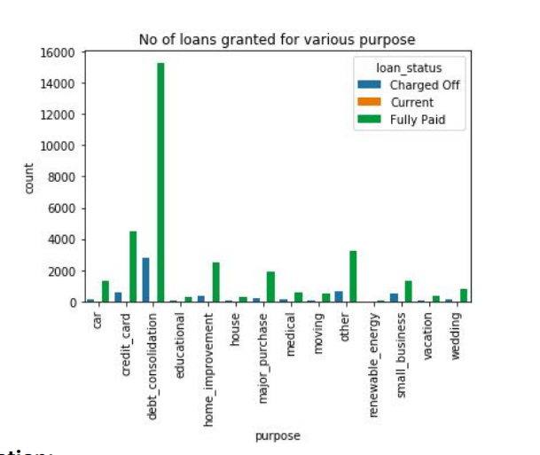
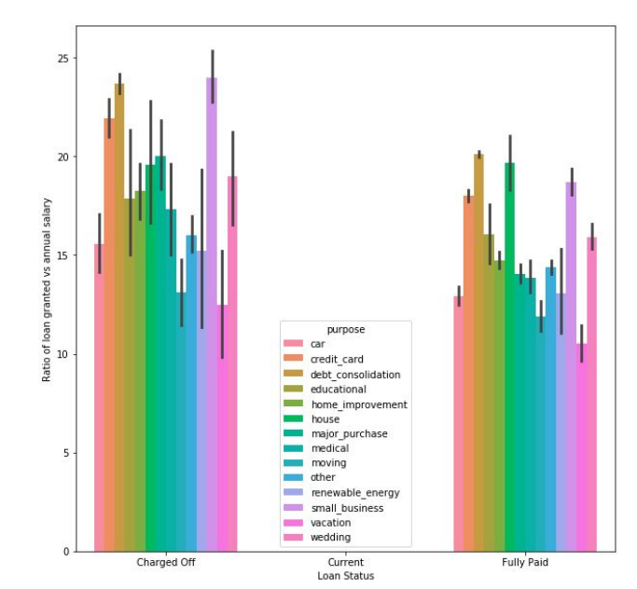
Purpose for applying Loan Analysis
Observation:
Most of the loans are granted were for debt consolidation.
Applicants having higher income tends to default the loan.

Slide 14
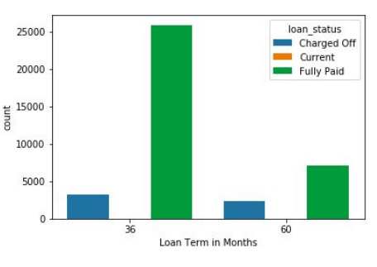
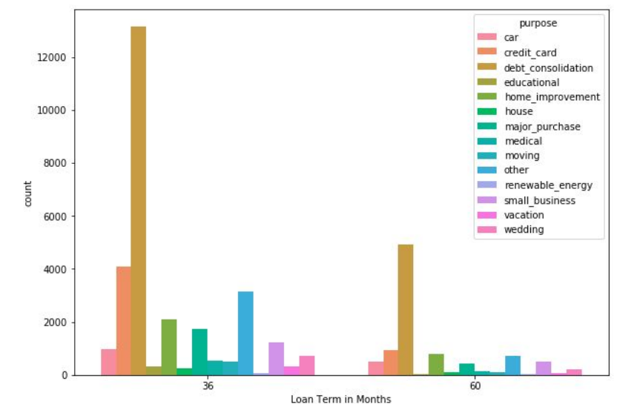
Loan Status vs Loan Tenure
Observation:
Most of the loans granted were of 36 months.
And loans granted for 36 months have slightly high tendency to default.
Additionally, Debt Consolidation is the most common purpose and loans are granted for 36 months and 60 months.

Slide 15
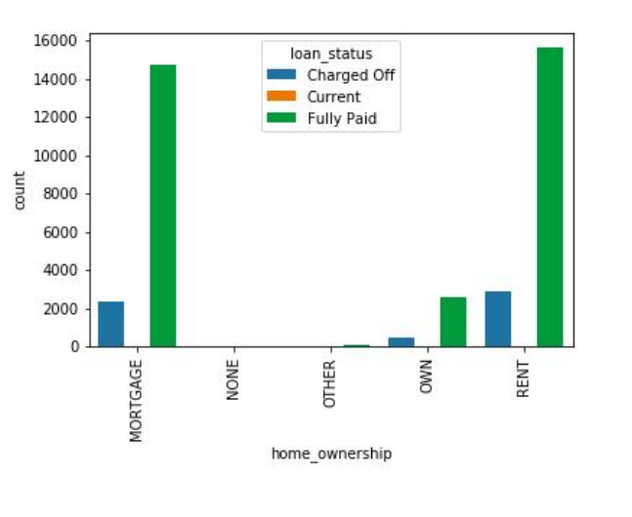
Loan Status by Home Ownership
Observation: Applicants having there home rented or on mortgage have almost equal tendency to default the loan.

Slide 16
Recommendations
Recommendations
Major Driving factor which can be used to predict the chance of defaulting and avoiding Credit Loss:
DTI
Grades
Verification Status
Annual income
Pub_rec_bankruptcies
Other considerations for 'defaults’ :
Burrowers not from large urban cities like California, New York, Texas, Florida etc.
Burrowers having annual income in the range 50000-100000.
Burrowers having Public Recorded Bankruptcy.
Burrowers with least grades like E,F,G which indicates high risk.
Burrowers with very high Debt to Income value.
Burrowers with working experience 10+ years.

